Slide 1
Voluntary Activity 5
Kinderstiftung Troisdorf

Slide 2
Table of contents
General information about non-governmental organizations
2. The foundation „Kinderstiftung Troisdorf“
3. Interview with a voluntary worker of the „Kinderstiftung Troisdorf“

Slide 3
Non governmental organization
What do these organizations do in general?
perform a wide range of services aimed towards human wellbeing and social work towards bringing a positive change in the society
Why are they important?
expression of civic engagement and a sign of democratic participation.
Who do they help?
people with financial hardship and those in need of assistance

Slide 4
We took a closer look at the organization Kinderstiftung Troisdorf
Since 2012, the Kinderstiftung Troisdorf ensures that children and young people can develop well
to recognize their strengths
to shape their lives
to develop into self-confident and committed young people.
financially support families who are in need
help young families with furniture and everything that children need
support them with any educational matters

Slide 5
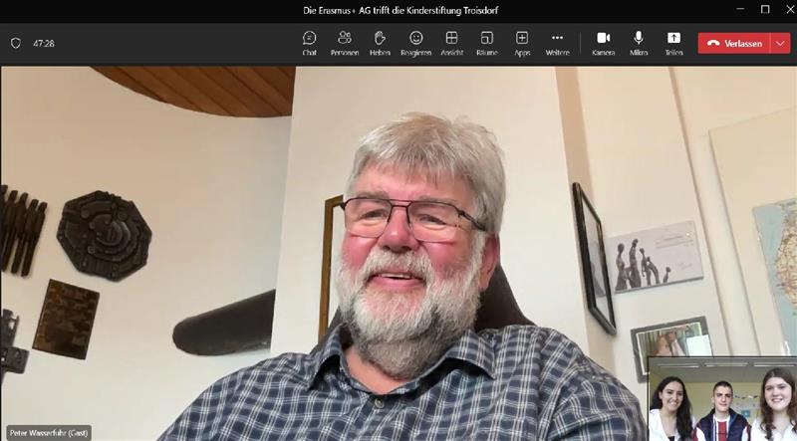
We had a video-call on teams with the Organization Kinderstiftung-Troisdorf.

Slide 6
Interview with one of the voluntary workers
When was the Kinderstiftung Troisdorf established?
March 2012
How did you come up with the idea of establishing a Kinderstiftung?
There were several people in 2010 who wanted to support children with social needs financially
Are there people who donate regulary?
Yes, there are about 50 people from Troisdorf, there are private citizens as well as companies donating

Slide 7
Can anyone who needs help come to you?
the foundation only helps children from Troisdorf, the social welfare office, the job center and youth welfare office cooperate with us
How do people become aware of you?
through the internet(website), newspaper articles, campaigns, presence at events such as the Christmas Markets.
What kind of donations do you accept?
money, donations in kind and any electronic devices
How long have you been volunteering?
2012, since my retirement

