Slide 1
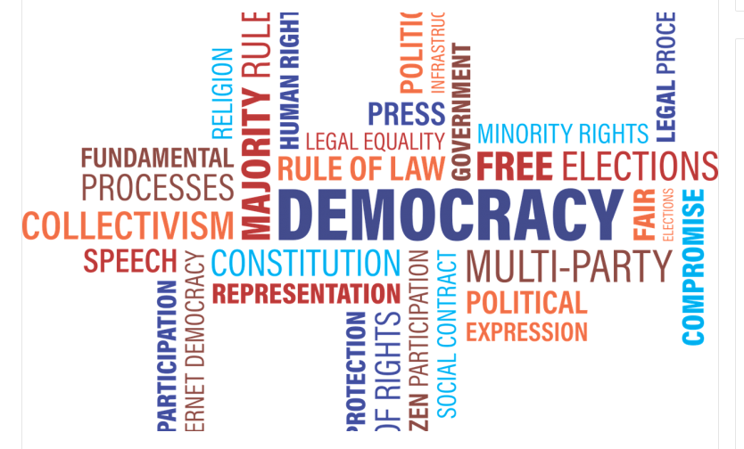
SEPTEMBER 15 DEMOCRACY DAY

Slide 2
What is democracy day ?
The 192 member general assembly, based on the idea that insentive efforts should be made toestablish democracy, development, respect for human rights and fundamental freedoms in all countries of the world, decided to use the date of September 15 as “Democracy Day” since 2008.

Slide 3
What is democracy?
Democracy is a kind of form of government in which all people in the world have an equal right to shape state policy.
Although it is generally considered as a form of government, many other institutions and organizations can also be managed with democracy.

Slide 4
Where and how did democracy come about?
His homeland was criticized by the philosophers Aristotle and Plato in Ancient Greece and was characterized by derogatory attitudes.
Howewer, democracy has become the most widely used state management system today by Decoupling from other forms of government.

Slide 5
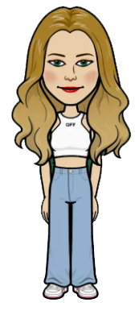
Words spoken about democracy
“Democracy is essentially individual, this quality is the citizen’s participation in sovereignty as a human being.”
Mustafa Kemal Atatürk
“All the diseases of democracy can be cured with more democracy.”
Alfred E.Smith

Slide 6
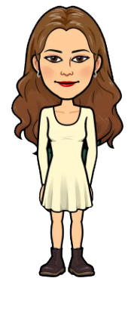
JNSODVIU
”Management that teaches you to dominate yourself is the best management.”
Goethe
“The true democtaric principle means that no one has power over the people.”
Lord Acton

Slide 7
“The participation of the people in the government of the state is the basis of democracy.”
Lyndon B. Johnson
“Democracy means respecting the ideas amd beliefs at the majority, but guaranteeing the freedom of opinion and consiense of the minority.”
Uğur Mumcu

Slide 8
Prepared: Zeynep Ceren Avcu

